Slide 1
Linear separable models

Slide 2
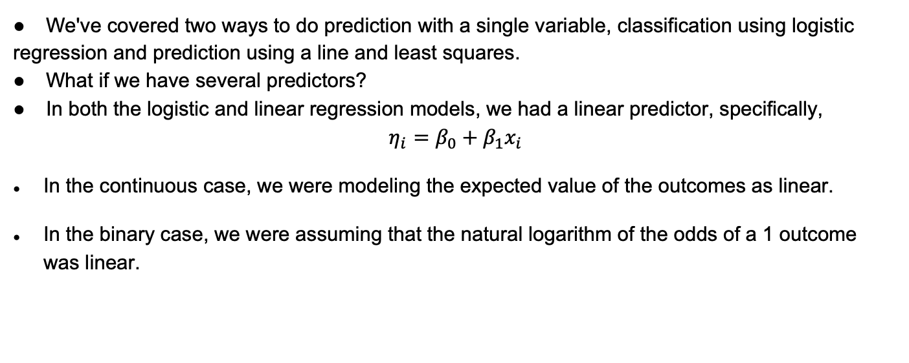
So far
We've covered two ways to do prediction with a single variable, classification using logistic regression and prediction using a line and least squares.
What if we have several predictors?
In both the logistic and linear regression models, we had a linear predictor, specifically,
$$η_{i}=β_{0}+β_{1}x_{i}$$
In the continuous case, we were modeling the expected value of the outcomes as linear.
In the binary case, we were assuming that the natural logarithm of the odds of a 1 outcome was linear.

Slide 3
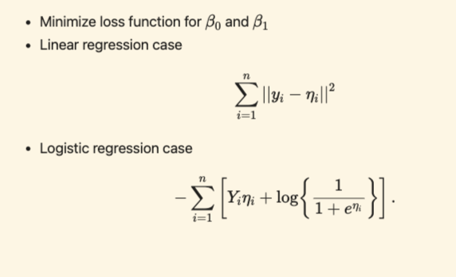
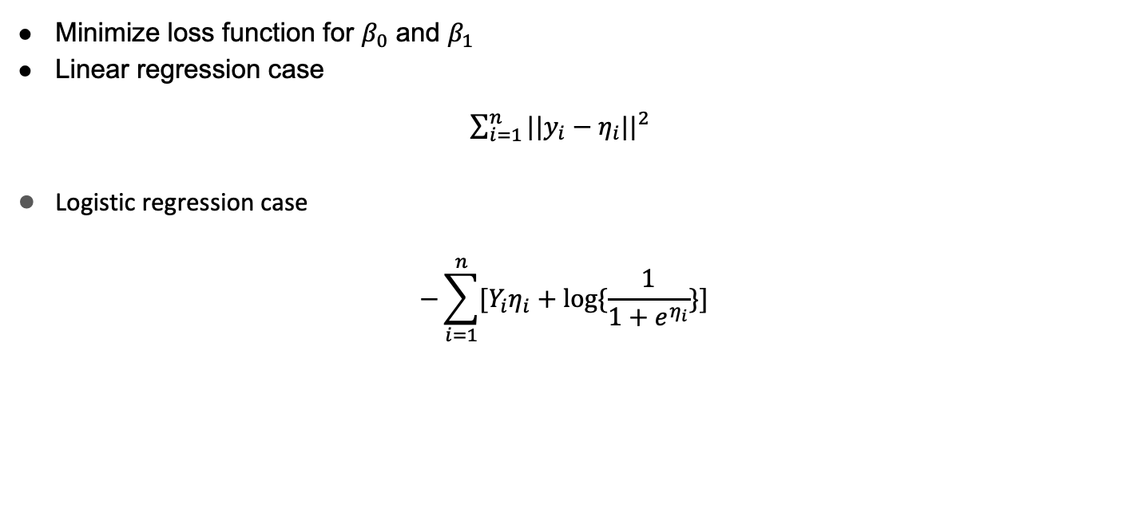
Estimation
Minimize loss function for $β_{0}$ and $β_{1}$
Linear regression case
$\sum_{i=1}^{n}{{||y_{i}−η_{i}||}^{2}}$
Logistic regression case
$$−\sum_{i=1}^{n}{[Y_{i}η_{i}+log⁡\{\frac{1}{1+e^{η_{i}}}\}]}$$

Slide 4
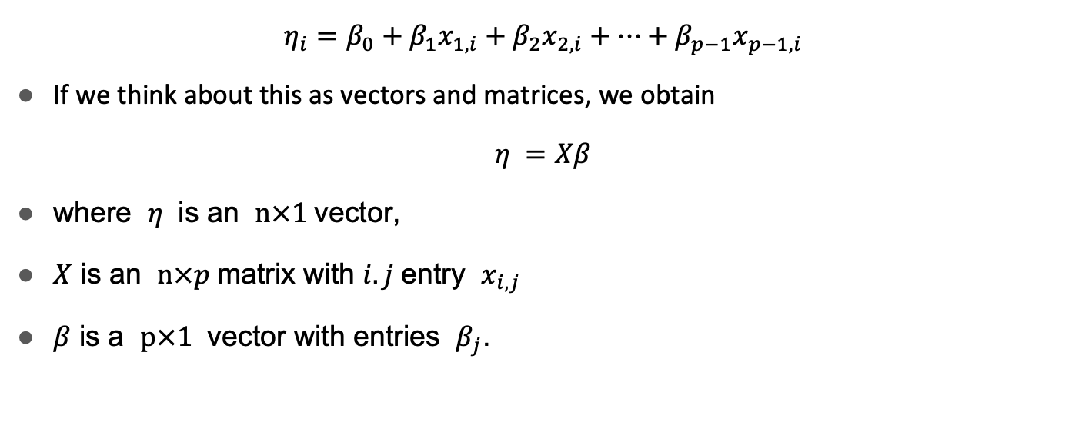
Extending these models
$$η_{i}=β_{0}+β_{1}x_{1,i}+β_{2}x_{2,i}+…+β_{p−1}x_{p−1,i}$$
If we think about this as vectors and matrices, we obtain
$$η =Xβ$$
where $η$ is an $n×1$vector,
$X$ is an $n×p$matrix with $i.j$entry $x_{i,j}$
$β$ is a $p×1$ vector with entries $β_{j}$.

Slide 5
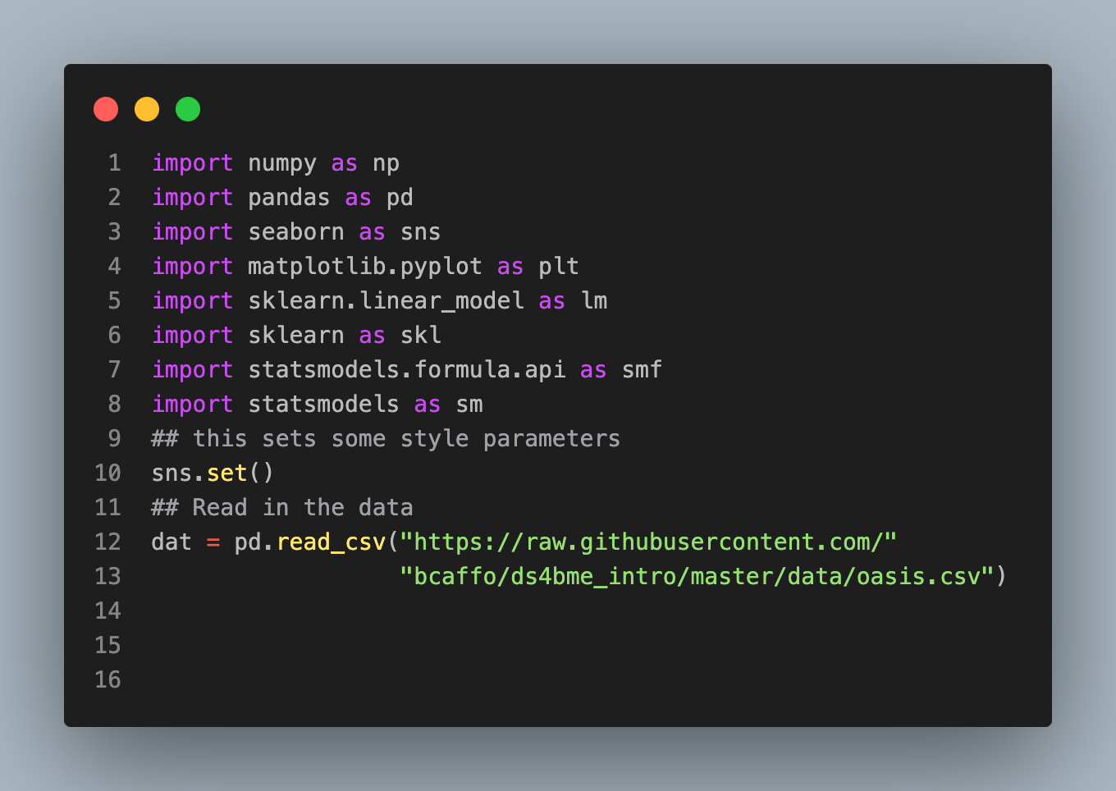

Slide 6
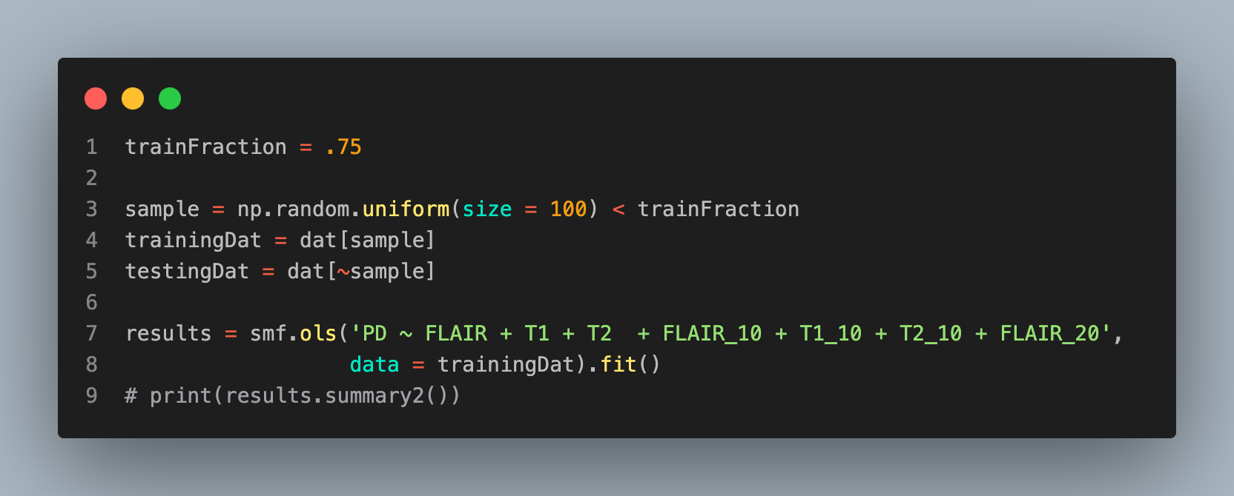
Proton density (PD) is the outcome,
Let's first try to fit the proton density data from the other imaging data.
# Truncated results
coef std err t P>|t| [0.025 0.975]
------------------------------------------------------------------------------
Intercept 0.2099 0.130 1.610 0.112 -0.050 0.470
FLAIR -0.0041 0.078 -0.053 0.958 -0.159 0.151
T1 -0.2987 0.089 -3.348 0.001 -0.477 -0.121
T2 0.5436 0.086 6.313 0.000 0.372 0.715
FLAIR_10 -0.0743 0.325 -0.228 0.820 -0.723 0.575
T1_10 0.2940 0.160 1.835 0.071 -0.026 0.614
T2_10 0.0066 0.310 0.021 0.983 -0.611 0.624
FLAIR_20 1.7173 0.696 2.466 0.016 0.328 3.106

Slide 7
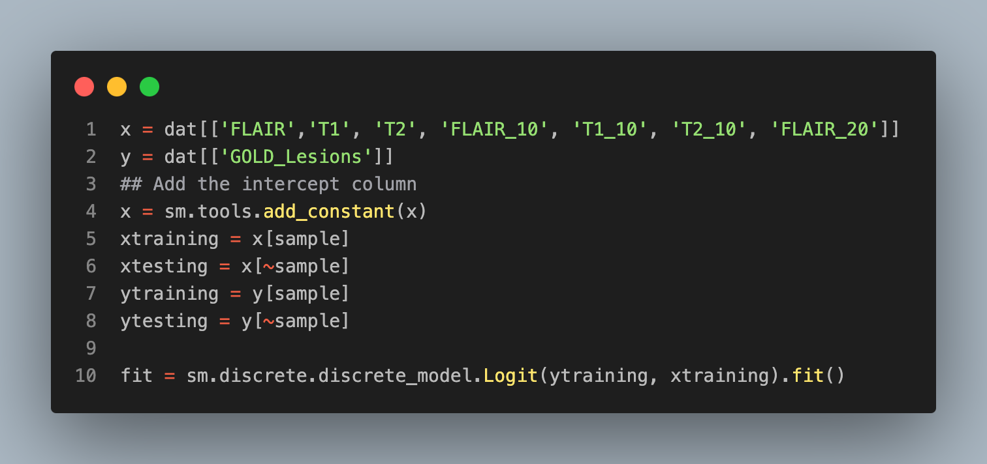
Logistic regression example
Optimization terminated successfully.
Current function value: 0.253764
Iterations 8

Slide 8
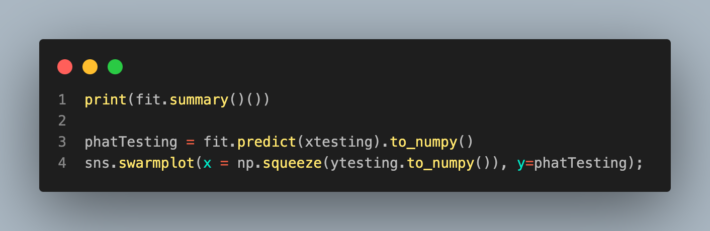
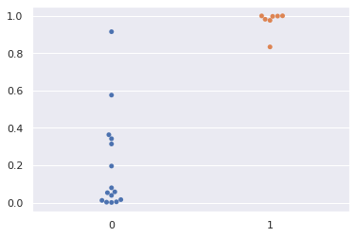
coef std err z P>|z| [0.025 0.975]
const -3.3909 1.767 -1.919 0.055 -6.854 0.072
FLAIR 1.5931 1.147 1.389 0.165 -0.655 3.841
T1 2.4984 1.086 2.301 0.021 0.371 4.626
T2 1.3153 0.994 1.323 0.186 -0.633 3.263
FLAIR_10 8.6555 3.678 2.353 0.019 1.446 15.865
T1_10 1.6271 1.850 0.879 0.379 -1.999 5.253
T2_10 -5.7317 3.572 -1.605 0.109 -12.732 1.269
FLAIR_20 -20.1731 8.786 -2.296 0.022 -37.392 -2.954

